Slide 1
QBIO 490 Literature Presentation on Ovarian Cancer
Matthew, Alice, Lucia

Slide 2
Introduction to the Papers
Review Paper: The Role of Omics Approaches to Characterize Molecular Mechanisms of Rare Ovarian Cancers: Recent Advances and Future Perspectives
Covers genomics, transcriptomics, proteomics, and metabolomics
Research Paper: Integrated Multi-omics Analysis of Ovarian Cancer Using Variational Autoencoders
This study discusses integrated multi-omics data
Covers genomics, transcriptomics, and epigenomics

Slide 3
Review Paper
Goals:
Look at the state of individual and multi -omics approaches and their use in studying ovarian cancer
Gain a better overall understanding of cancer research; look into therapies, drug resistance, cancer recurrence, prognosis, etc. that have been discovered through -omic approaches
Methods:
Survey of 104 journal-published papers about ovarian cancer -omic data
Notes:
Overview how -omic approaches can give us a better understanding of rare ovarian cancer types
>50% of ovarian cancers

Slide 4
Review Paper
Results:
Genomics
identify new subtypes of rare ovarian cancers such as clear cell carcinoma, mucinous carcinoma, LGSOC
Transcriptomics
insights on biomarkers, temporal gene upregulations, gene fusions, and potential druggable sites
scRNA-sc is emerging as a way to look at the transcriptome of single cells
Proteomics
still a young field of study, but has been used to find post-translational protein modifications
Metabolomics
found potential biomarkers in ovarian cancers but not many studies have been published
Notes:
Genomics:
Emboldened by PCR and NGS technology
associated genetic mutations
Transcriptomics:
approaches have increased with the addition of RNA-seq instead of microarrays
scRNA-sc (cell types, proportions, signaling mechanisms)
Proteomics:
garnering new info on cancer pathways and biomarkers with the modifications
Metabolomics:
New high-throughput technologies with NMRS (Nuclear Magnetic Resonance Spectroscopy) and MS (Mass Spectroscopy) have enabled metabolomics research

Slide 5
Review Paper
More Results:
Since cancer is multi-faceted and affects many layers of the central dogma, multi-omic approaches using machine learning and AI are starting to be built and deployed
Can better find linear and non-linear processes
Better identify biomarkers, therapeutic targets, and causes of cancer
Cancer recurrence and drug resistance pathways have been studied and some causes of both have been found
Takeaways:
Individual omics and multi-omics approaches have greatly increased knowledge of both rare and common ovarian cancers
Research of rare ovarian cancers has especially blossomed with greater availability of biological data and we have found much more information on them than previously known
Novel biomarkers, therapies, and personalized care has been achieved through omics data
Notes:
Non-Linear processes: pathway cross-talk, transcriptional regulatory networks, feedback loops, spatial regulation of signaling intermediates, etc
Drug resistance found: platinum chemotherapy drug inactivation by metallothionein and thiol glutathione, which activates the detoxification system.
Diagnosing: neural network analysis on ncRNA data from EOCs to produce an algorithm to diagnose Epithelial ovarian cancers

Slide 6
Research Paper
Hypothesis:
DL based integrated multi-omics analysis difficult, as data is imbalanced with too many molecular features and relatively few patient samples
DL-based dimensionality reduction technique, including variational autoencoder (VAE), is a potential solution to balance high dimensional multi-omics data.
Method:
Monomics, diomics, tri-omics datasets from TCGA (i.e., mRNA, CNV/CNA, DNA methylation, RNAseq, and miRNA)
Preprocessed: intersected the mono-omics datasets to find the common and same size samples; identified and removed the missing/zero/NA values; normalise datasets using the min-max technique so that they have equal importance in analysis; concatenated to form the di- and tri-omics datasets

Slide 7
Research Paper
Method:
Construct Standard VAE and MMD-VAE (an improved version of VAE, namely Maximum Mean Discrepancy) respectively
Implement them using the same architecture
Clustering and classification in cancer: 4 ovarian cancer transcriptional subtypes; VAE or MMD-VAE generated latent and compressed features (z or LFs) can be used to cluster and classify cancer samples, subtypes, including existing transcriptional or molecular subtypes of ovarian cancer
Survival analysis: identification of robust survival subgroups; existing subtypes may not be useful, so we need to find the prognostic biomarkers to predict new subgroups

Slide 8
Research Paper
Main Findings:
VAE and MMD-VAE outperform existing dimensionality reduction techniques
Integrated di- and tri-omics based LFs can perform better or similar to their mono-omics counterparts based LFs
Molecular subtypes clustering and classification results show that MMD-VAE is outperforming VAE in most datasets
Limitations:
Multi-omics based LFs and subgroups predicted based on them do not improve the survival prediction performances than their mono-omics counterparts
Straightforward integration (concatenation based) strategy, treating omics measurements from different platforms equally and performing integration in a parallel fashion may not always be useful

Slide 9
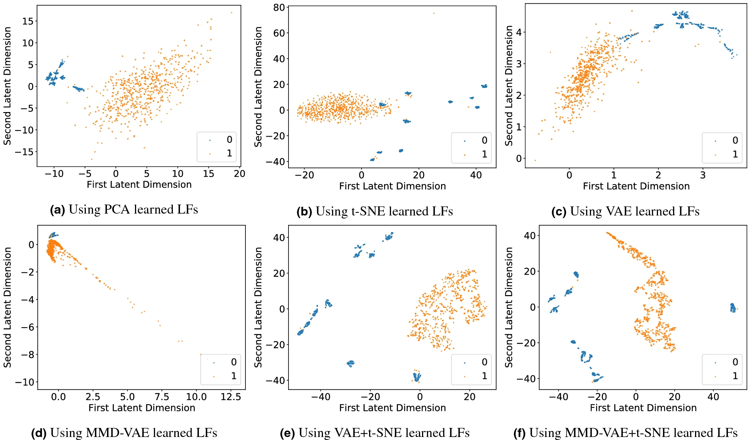
Figure 1
Used the GDC TCGA Ovarian Cancer cohort (DNA methylation)
Demonstrates clustering between normal and cancer data when using unsupervised VAE, unsupervised MMD-VAE, PCA, and t-SNE to learn the labeling functions
Chose clustering as visual way to demonstrate separation between cancer/normal data

Slide 10
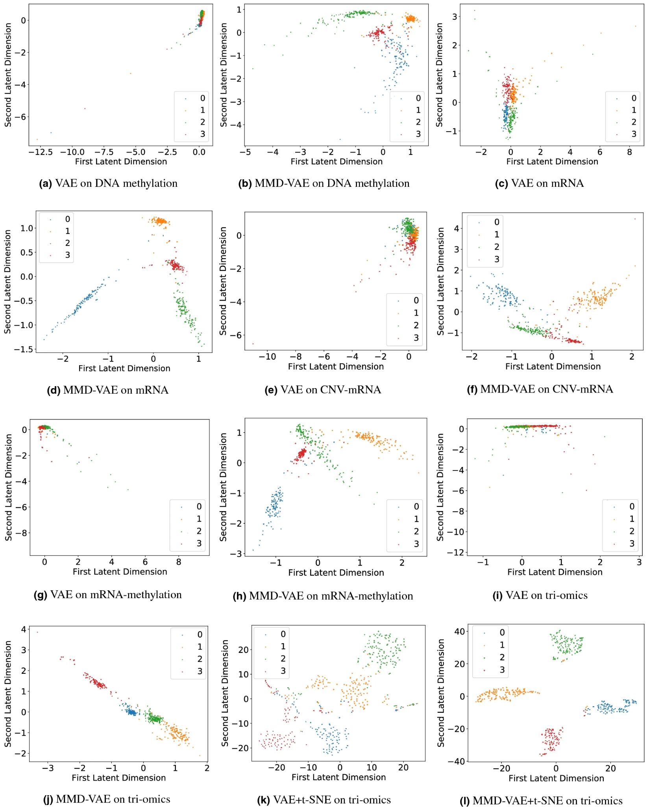
Figure 2
0—Immunoreactive, 1—Differentiated, 2—Proliferative and 3—Mesenchymal.
Used TCGA Ovarian Cancer cohort mRNA, CNV/CNA + RNAseq, DNA methylation, and combinations of the above (di-omics and tri-omics)
Demonstrates clustering between four molecular subtypes with supervised VAE, supervised MMD-VAE, t-SNE, and combinations of the above
Chose clustering as visual way to demonstrate separation between molecular subtypes

Slide 11
Questions/Future Investigations
How can we better improve AI so that it is more accurate in predicting cancers?
Look into making transcriptomic, proteomic, and metabolomic more accessible (easier/faster) so that we can get better data?
Set international standards on data collections so that we can get a more standard approach?
How can we weigh different types of omics data efficiently?

